Slide 1
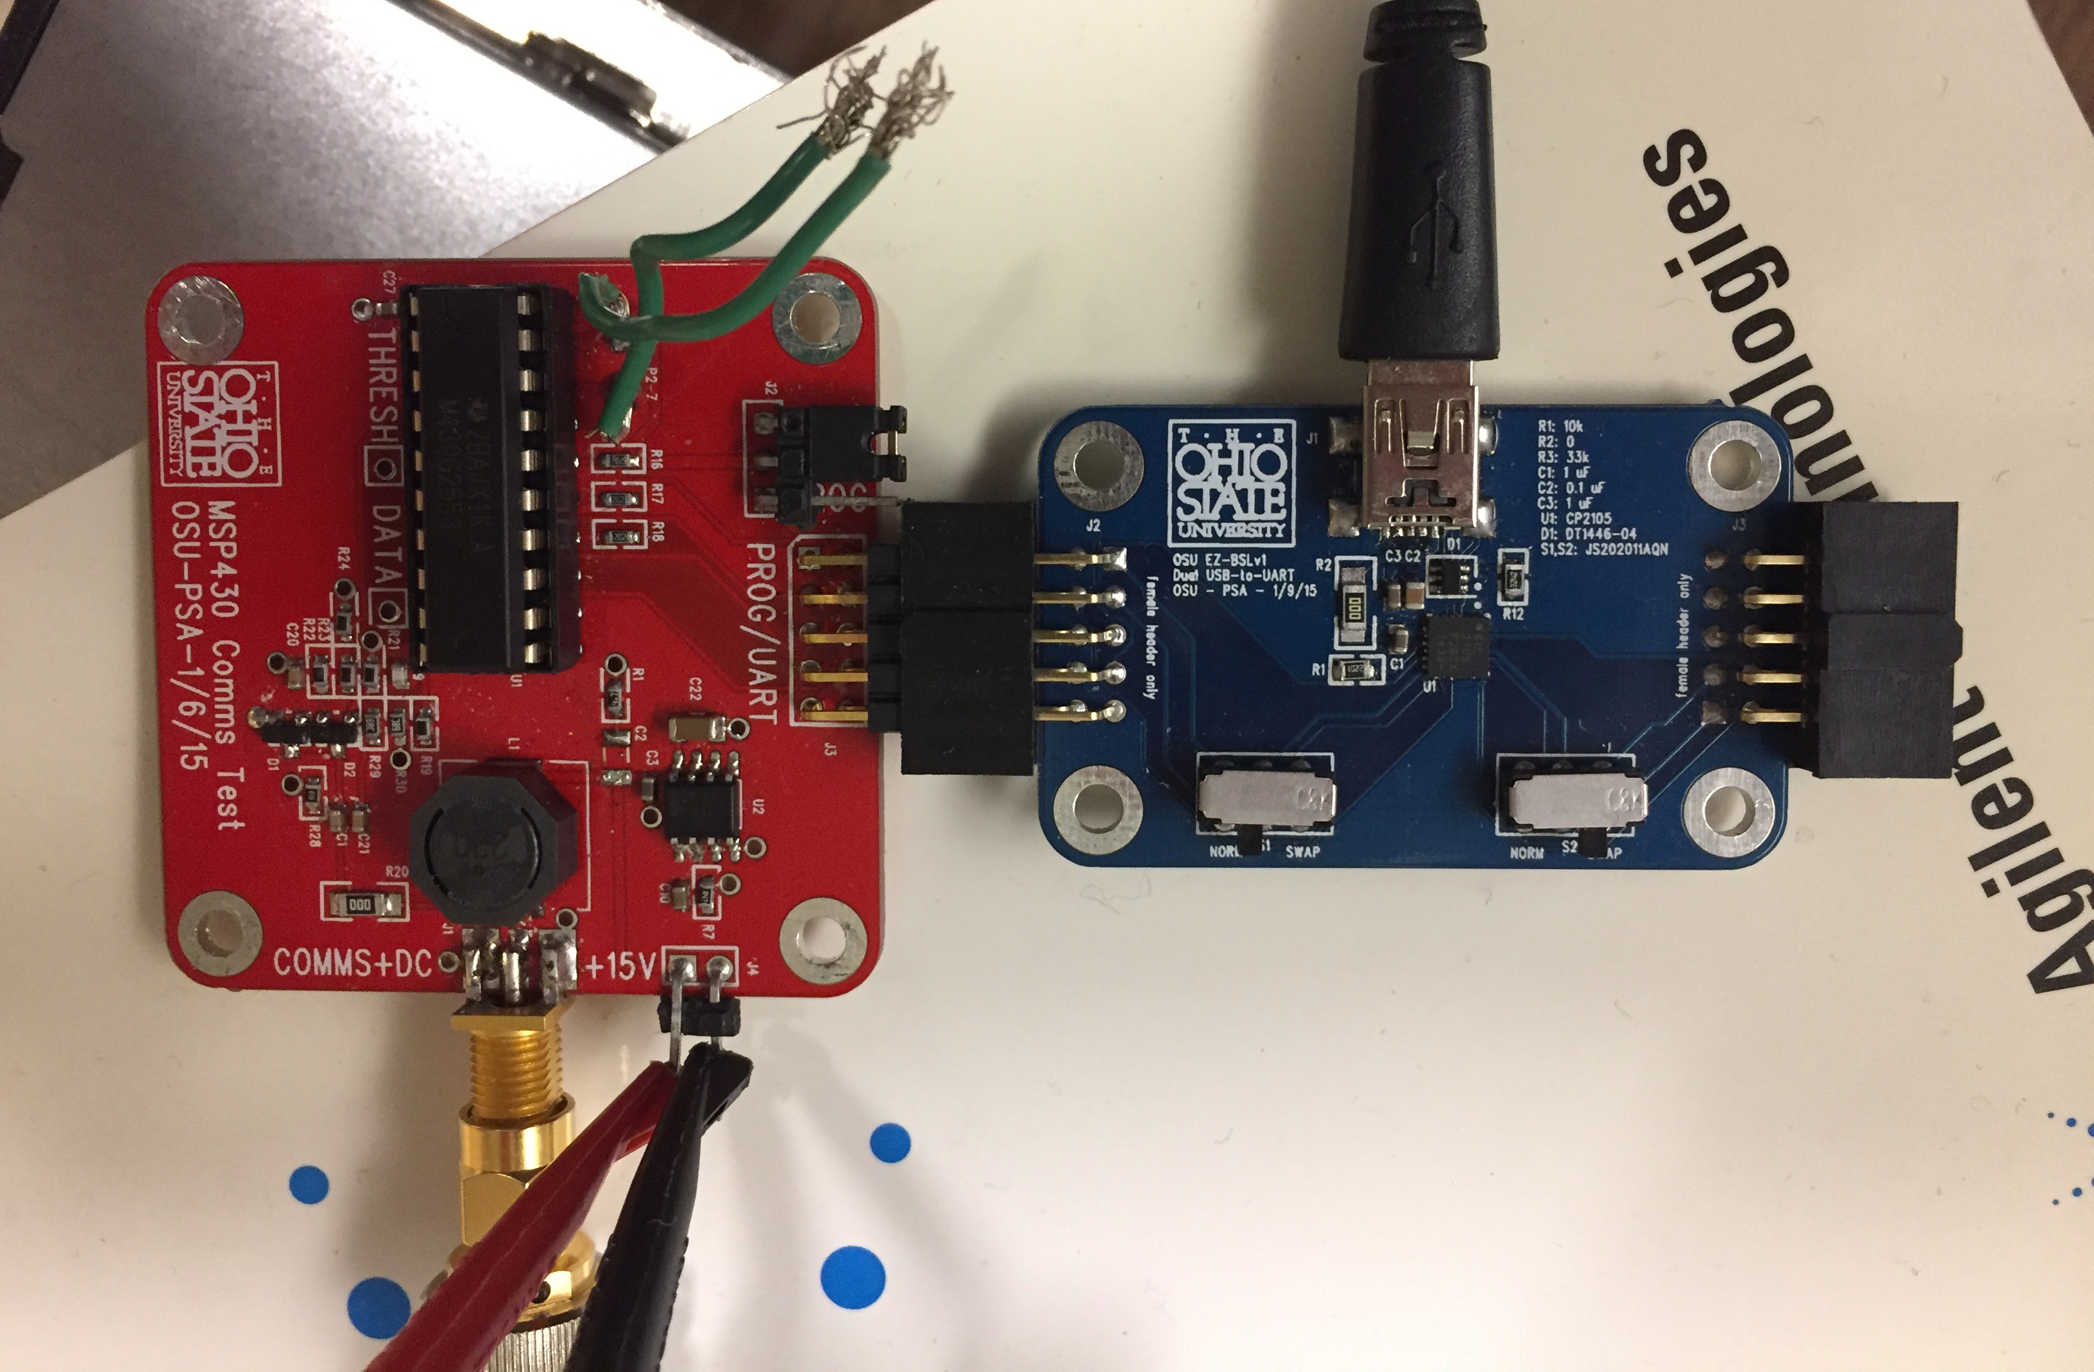
USB from Computer
USB Mini/J1
MSP430 Comms Tester
USB-to-UART Converter
SMA
J4
Power out to Quad
+15V /GND input
from DC power source

Slide 2
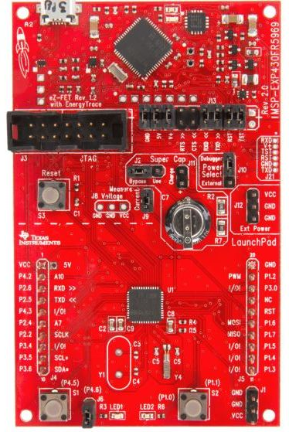
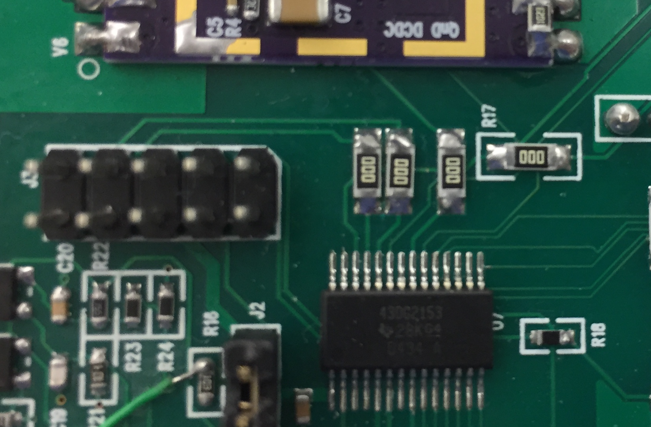
9 | 7-TEST | 5-GND | 3-BSL_RX_UART_TX | 1-BSL_TX_UART_RX
10 | 8-VCC | 6-VCC | 4-RST | 2

Slide 3
